Slide 1

UNIVERSITY INSTITUTE OF ENGINEERING
COMPUTER SCIENCE ENGINEERING
Master of Engineering
ADVANCED DATA STRUCTURES
&
ALGORITHMS
(23CSH-622)
INTRODUCTION
DISCOVER . LEARN . EMPOWER

Slide 2

ADVANCED DATA STRUCTURES
&
ALGORITHMS
(23CSH-622)
By : Dr. Ranjit Singh (E10947)
www. cuchd.in Campus : Gharaun, Mohali

Slide 3
BINARY SEARCH TREES
Course Outcome
Will be covered in this lecture
CO Number | Title | Level
CO1 | To understand role of algorithms in science and practice of computing.. | Remember
CO2 | To gain familiarization with different algorithm design techniques. | Understand
CO3 | To apply different algorithm design techniques for solving engineering and related problems and study their performance. | Analysis and application

Slide 4
Lecture Objectives
To impart the concepts of Binary search tree.
To understand the algorithm to insert in BST
To Understand the algorithm for deletion in BST.
Lecture Outcome:-Students will
Understand the concepts of Binary search tree
Understand the insertion and deletion algorithms of BST.

Slide 5
TOPICS TO BE COVERED
Binary Search Trees(BST)
Need for BST
Algorithm for searching in a BST
Inorder Traversal of BST
Algorithm for inserting in a BST
Deleting in a Binary Search Tree

Slide 6
Need of BST
In case of binary trees we need to insert elements in any order just by following conditions of having at most two children.
This will make searching of element very difficult.

Slide 7
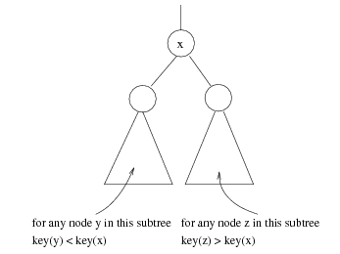
Binary Search Trees (BST)
A data structure for efficient searching, insertion and deletion
Binary search tree property
For every node X
All the keys in its left subtree are smaller than the key value in X
All the keys in its right subtree are larger than the key value in X

Slide 8
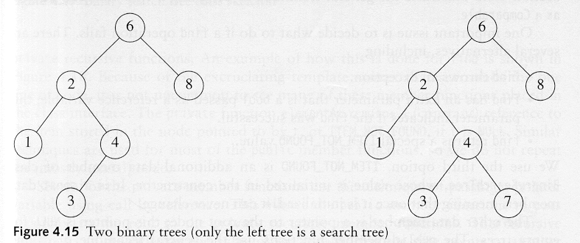
Binary Search Trees
A binary search tree
Not a binary search tree

Slide 9
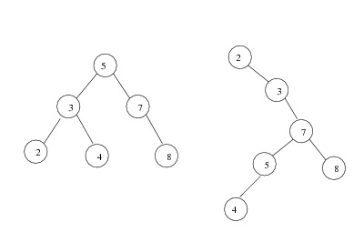
Binary Search Trees
The same set of keys may have different BSTs
Average depth of a node is O(log N)
Maximum depth of a node is O(N)

Slide 10
Height
The total number of nodes, n, in the tree is equal to the sum of the nodes on all the levels (complete tree)
1 + 2^1 + 2^2 + 2^3 + ... + 2^(h−1) = n
(2^ h) − 1 = n
2^ h = n + 1
log 2^ h = log (n + 1)
h = log (n + 1)

Slide 11
Algorithm for searching in a BST
FIND(INFO,LEFT,RIGHT,ROOT,ITEM,LOC,PAR) : A binary search tree T is in memory and an ITEM of information is given. This procedure finds the location LOC of ITEM in T and also location PAR of the parent of ITEM. There are 3 special cases:
(i) LOC=NULL and PAR=NULL will indicate that the tree is empty..
(ii) LOC≠NULL and PAR=NULL will indicate that the ITEM is the root of T.
(iii) LOC=NULL and PAR≠NULL will indicate that ITEM is not in T and can be added to T as a child of the node N with location PAR.
[Tree empty?]
If ROOT=NULL, then, Set LOC=NULL and PAR=NULL and return.
[ITEM at root?]
If ITEM=INFO[ROOT], then: Set LOC=ROOT and PAR=NULL and return.
[Initialize pointers PTR and SAVE]
If ITEM<INFO[ROOT], then:
Set PTR=LEFT[ROOT] and SAVE=ROOT
Else
Set PTR=RIGHT[ROOT] and SAVE=ROOT
[End of If structure]
Repeat steps 5 to 6 while PTR≠NULL:
[ITEM found?]
If ITEM=INFO[PTR], then: Set LOC=PTR and PAR=SAVE and return.
If ITEM<INFO[PTR], then:
Set SAVE=PTR and PTR=LEFT[PTR]
Else
Set SAVE=PTR and PTR=RIGHT[PTR]
[End of If structure]
[End of step4 loop]
7. [Search unsuccessful] Set LOC=NULL and PAR=SAVE
8. Exit

Slide 12
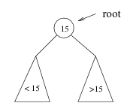
Searching BST
If we are searching for 15, then we are done.
If we are searching for a key < 15, then we should search in the left subtree.
If we are searching for a key > 15, then we should search in the right subtree.

Slide 13
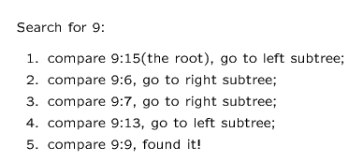
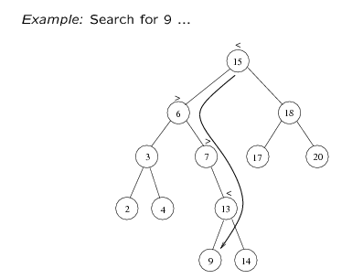

Slide 14
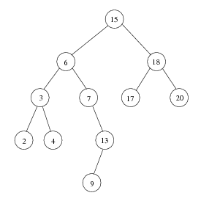
Inorder Traversal of BST
Inorder traversal of BST prints out all the keys in sorted order
Inorder: 2, 3, 4, 6, 7, 9, 13, 15, 17, 18, 20

Slide 15
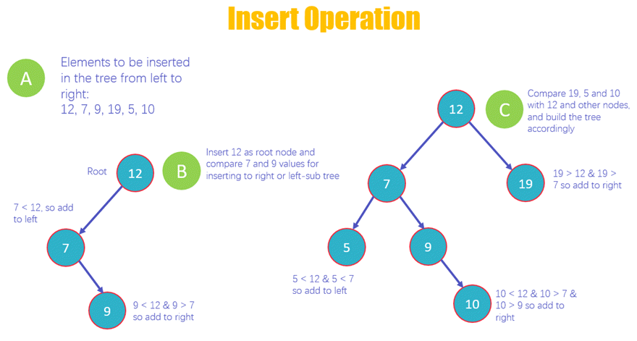
Insertion in BST

Slide 16
Algorithm for inserting in a BST
INSBST(INFO,LEFT,RIGHT,ROOT,AVAIL,ITEM,LOC) : A binary search tree T is in memory and an ITEM of information is given. This procedure finds the location LOC of ITEM in T or adds ITEM as a new node in T at location LOC.
1. Call FIND(INFO,LEFT,RIGHT,ROOT,ITEM,LOC,PAR)
2. If LOC≠NULL, then: Exit.
3. [Copy ITEM into new node in AVAIL list.]
(a)If AVAIL=NULL, then: Write: OVERFLOW & Exit.
(b)Set NEW=AVAIL, AVAIL=LEFT [AVAIL] & INFO [NEW] =ITEM.
(c)Set LOC=NEW, LEFT[NEW]=NULL & RIGHT[NEW]=NULL
4. [Add ITEM to tree]
If PAR=NULL, then:
Set ROOT=NEW [Make it root]
Else if ITEM<INFO [PAR], Then:
Set LEFT [PAR] =NEW
Else
Set RIGHT [PAR] =NEW
[End of if structure]
5. Exit

Slide 17
Deleting in a Binary Search Tree
Algorithm:
If ROOT = NULL, then: Underflow and exit
If ROOT≠NULL , check:
If node to be deleted is a leaf node, then:
Directly delete leaf node.
else if node to be deleted has no left subtree, then:
Right child will take place of the parent node deleted.
else if node to be deleted has no right subtree, then:
left child will take place of the parent node deleted.
else if node to be deleted has left and right subtrees, then:
either of the 2 methods can be implemented:
(a) Find highest valued element among the descendants of left child & replace it with deleted node.
(b) Find lowest valued element among the descendants of right child and replace it with deleted node.
3. Exit
Inorder predecessor/successor

Slide 18
Deletion
When we delete a node, we need to consider how we take care of the children of the deleted node.
This has to be done such that the property of the search tree is maintained.

Slide 19
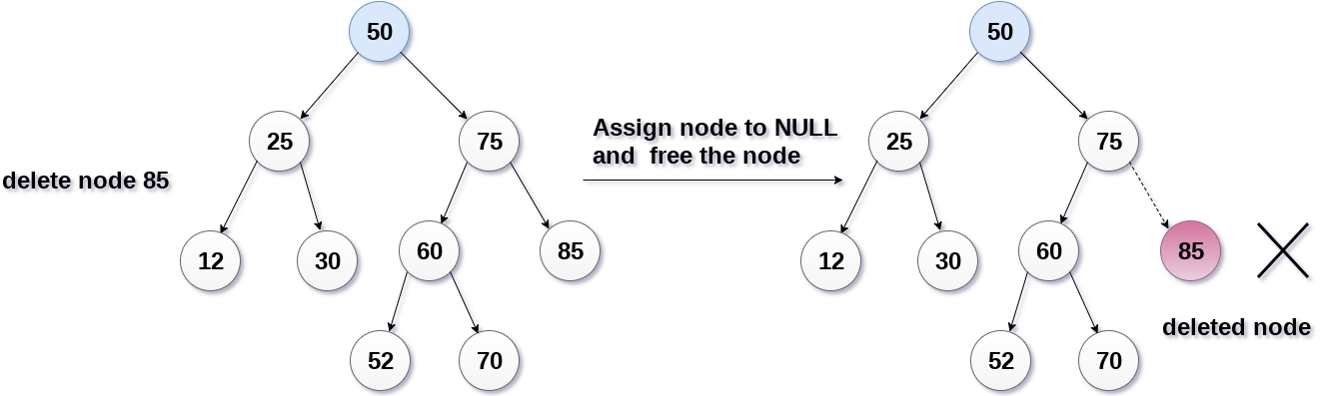
A)The node to be deleted is a leaf node It is the simplest case, in this case, replace the leaf node with the NULL and simple free the allocated space.

Slide 20
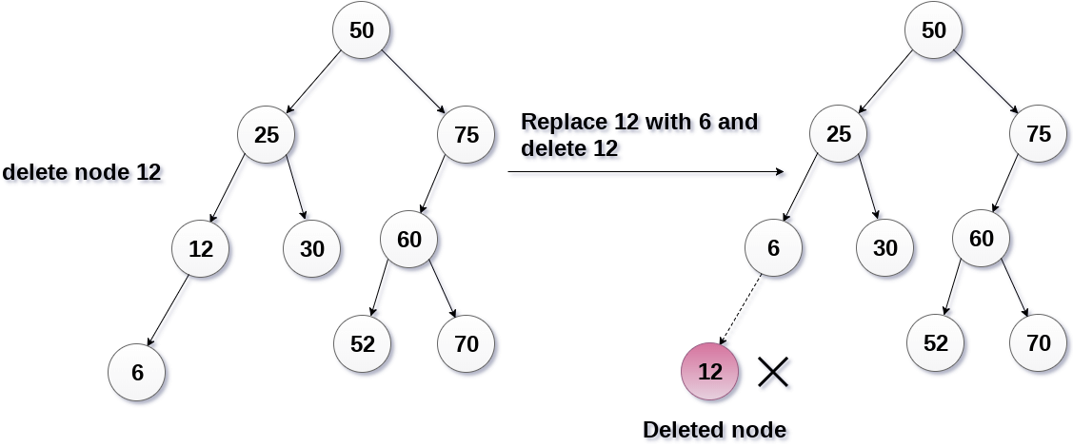
B) The node to be deleted has only one child. In this case, replace the node with its child and delete the child node, which now contains the value which is to be deleted. Simply replace it with the NULL and free the allocated space.

Slide 21
C) The node to be deleted has two children.
The node to be deleted has two children.
However, the node which is to be deleted, is replaced with its in-order successor or predecessor recursively until the node value (to be deleted) is placed on the leaf of the tree. After the procedure, replace the node with NULL and free the allocated space.
In the following image, the node 50 is to be deleted which is the root node of the tree. The in-order traversal of the tree given below.
6, 25, 30, 50, 52, 60, 70, 75.
replace 50 with its in-order successor 52. Now, 50 will be moved to the leaf of the tree, which will simply be deleted.

Slide 22
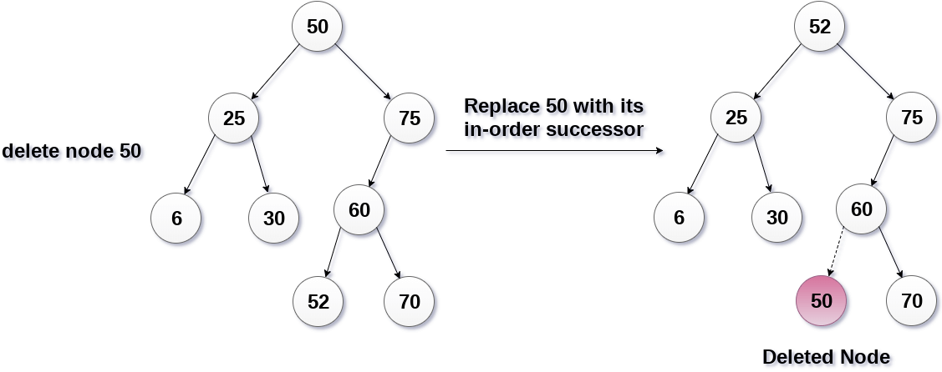

Slide 23
For n=4,
No. of Binary search tree= 14
No. of Binary trees=336
Total number of possible Binary Search Trees with n different keys = 2nCn / (n + 1)
And Total number of possible Binary Trees with n different keys = (2nCn / (n + 1)) * n!

Slide 24
References
Li`pschutz, Seymour, “Data Structures”, Schaum's Outline Series, Tata McGraw Hill.
Data structure and algorithm by Narasimha Karumanchi.
www.tutorialspoint.com
www.geeksforgeeks.com
24

Slide 25
Books Recommended
Goodrich, Michael T., Tamassia, Roberto, and Mount, David M., “Data Structures and Algorithms in C++”, Wiley Student Edition.
Aho, Alfred V., Ullman, Jeffrey D., Hopcroft ,John E. “Data Structures and Algorithms”, Addison Wesley
Lipschutz, Seymour, “Data Structures”, Schaum's Outline Series, Tata McGraw Hill.
Gilberg/Forouzan,” Data Structure with C ,Cengage Learning.
Augenstein,Moshe J , Tanenbaum, Aaron M, “Data Structures using C and C++”, Prentice Hall of India

